Slide 1
Machine Learning
Kashif Bilal

Slide 2
What is Machine Learning
In his 1950 paper, “Computing Machinery and Intelligence,” Alan Turing asked, “Can machines think?”
The paper describes the “Imitation Game,” which involves three participants—a human acting as a judge, another human, and a computer that is attempting to convince the judge that it is human. The judge would type into a terminal program to “talk” to the other two participants. Both the human and the computer would respond, and the judge would decide which response came from the computer. If the judge couldn’t consistently tell the difference between the human and computer responses, then the computer won the game.

Slide 3
Definition
In 1959, Arthur Samuel defined machine learning as a field of study that “gives computers the ability to learn without being explicitly programmed.
T. Mitchel defined AI as
A computer program is said to learn from experience E with respect to some class of tasks T and performance measure P, if its performance at tasks in T, as measured by P, improves with the experience E.
In spam classification, the task would be to classify a mail, experience may be to watch/learn the user to flag spam/not spam, and the performance measure may br the accuracy
So, with a computer running a set of tasks, the experience should be leading to performance increases.
Spam detection, voice recognition, stock trading (70% is done), Robotics, healthcare (vitals), MRI, x-ray diagnosis etc., advertising, ecommerce (target’s baby coupons problem)
Notes:
Example: playing checkers.
E = the experience of playing many games of checkers
T = the task of playing checkers.
P = the probability that the program will win the next game.
Machine learning is a branch of artificial intelligence. Using computing, we design systems that can learn from data in a manner of being trained. The systems might learn and improve with experience and, with time, refine a model that can be used to predict outcomes of questions based on the previous learning.

Slide 4
Supervised Learning
In supervised learning, we are given a data set and already know what our correct output should look like, having the idea that there is a relationship between the input and the output.
Supervised learning problems are categorized into "regression" and "classification" problems.
In a regression problem, we are trying to predict results within a continuous output, meaning that we are trying to map input variables to some continuous function.
In a classification problem, we are instead trying to predict results in a discrete output. In other words, we are trying to map input variables into discrete categories.
Given data about the size of houses on the real estate market, try to predict their price. Price as a function of size is a continuous output, so this is a regression problem.
We could turn this example into a classification problem by instead making our output about whether the house "sells for more or less than the asking price." Here we are classifying the houses based on price into two discrete categories.
(a) Regression - Given a picture of a person, we have to predict their age on the basis of the given picture
(b) Classification - Given a patient with a tumor, we have to predict whether the tumor is malignant or benign.

Slide 5
Unsupervised Learning
On the opposite end of this spectrum is unsupervised learning, where you let the algorithm find a hidden pattern in a load of data. With unsupervised learning there is no right or wrong answer; it’s just a case of running the machine learning algorithm and seeing what patterns and outcomes occur.
Unsupervised learning allows us to approach problems with little or no idea what our results should look like. We can derive structure from data where we don't necessarily know the effect of the variables.
We can derive this structure by clustering the data based on relationships among the variables in the data.
Clustering: Take a collection of 1,000,000 different genes, and find a way to automatically group these genes into groups that are somehow similar or related by different variables, such as lifespan, location, roles, and so on.

Slide 6
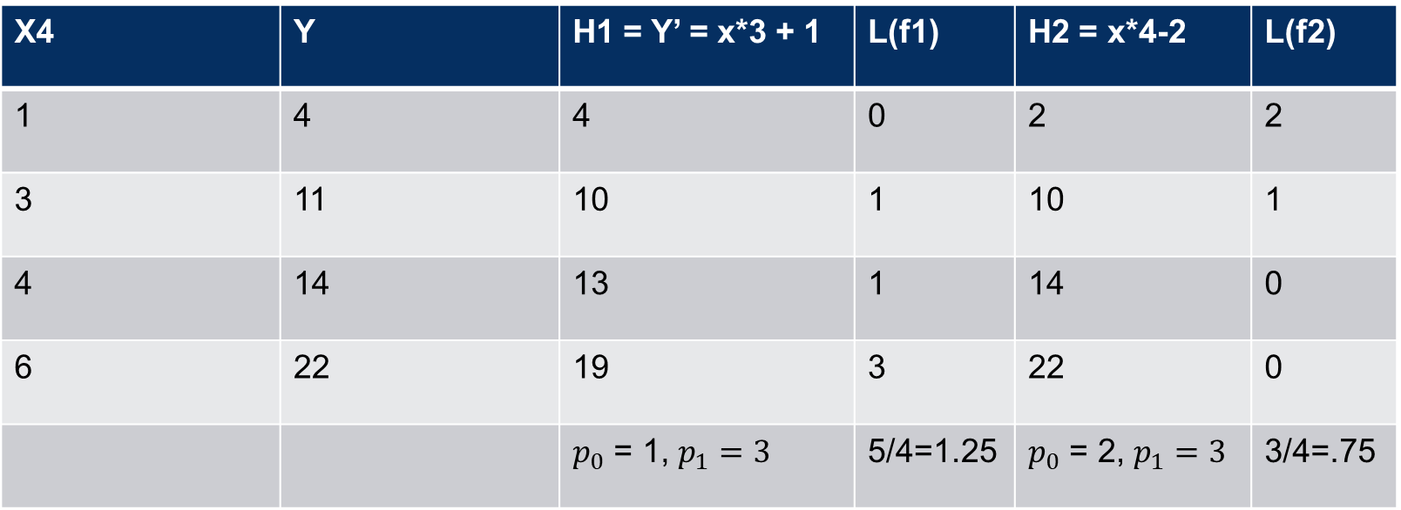
How machine learning works?
X4 | Y | H1 = Y’ = x*3 + 1 | L(f1) | H2 = x*4-2 | L(f2)
1 | 4 | 4 | 0 | 2 | 2
3 | 11 | 10 | 1 | 10 | 1
4 | 14 | 13 | 1 | 14 | 0
6 | 22 | 19 | 3 | 22 | 0
 |  | $p_{0}$ = 1, $p_{1}=3$ | 5/4=1.25 | $p_{0}$ = 2, $p_{1}=3$ | 3/4=.75

Slide 7
Notions
we’ll use x^{(i)} to denote the “input” variables (living area in this example), also called input features, and y^{(i)} to denote the “output” or target variable that we are trying to predict (price).
i defines the i^{th} row or i^{th} input or output
A pair (x^{(i)}, y^{(i)}) is called a training example
A list of m training examples {(x(i), y(i)); i = 1, . . . , m}—is called a training set that is use to learn the model to find the relation between x and y for prediction.
Note that the superscript “(i)” in the notation is simply an index into the training set, and has nothing to do with exponentiation.
We will also use X denote the space of input values, and Y the space of output values.

Slide 8
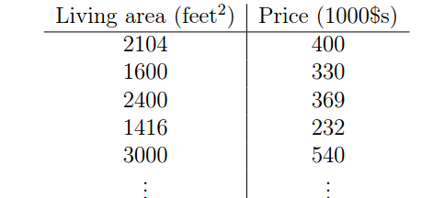
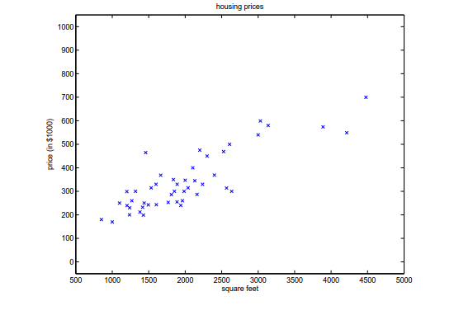
Supervised Learning
Suppose we have a dataset giving the living areas and prices of 47 houses
Given data like this, how can we learn to predict the prices of other houses in area, as a function of the size of their living areas?
X ⁽¹⁾ = 2104, X ⁽²⁾ = 1600, X ⁽³⁾ = 2400 ; Y ⁽¹⁾ = 400, Y ⁽²⁾ = 330, Y ⁽³⁾ = 369
Dataset = { (2104,400), (1600, 330) …… }

Slide 9
Model
A model defines/captures the relation between the input and output
Some times called relation between independent variables and dependent variables.
Loss of objective function is one that tells us how accurate our model is
We have to optimize the loss function, e.g., minimize the squared function
Training data set
Input data, which is sometimes referred to as features.
Training examples, which include a good number of (xi, yi) pairs; that is, the output for each input.
When the target variable that we’re trying to predict is continuous, such as in our housing example, we call the learning problem a regression problem.
When y can take on only a small number of discrete values (such as if, given the living area, we wanted to predict if a residence is a house or an apartment, say), we call it a classification problem.

Slide 10
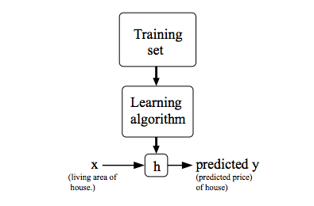
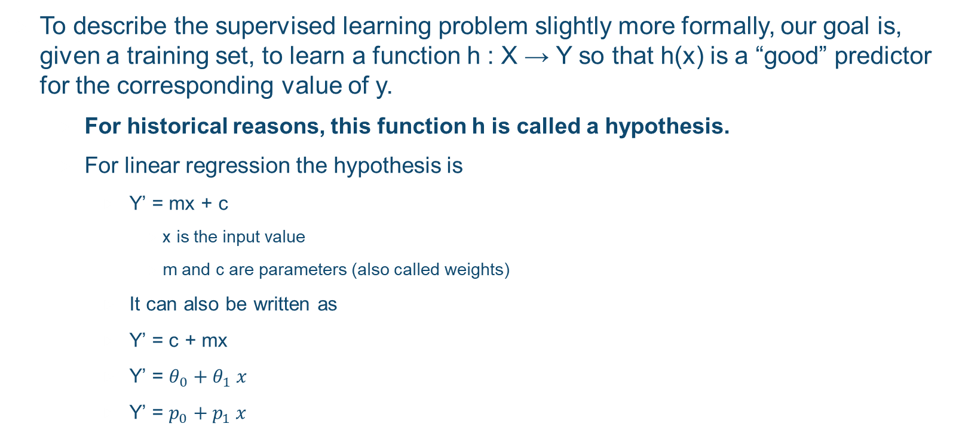
Hypothesis
To describe the supervised learning problem slightly more formally, our goal is, given a training set, to learn a function h : X → Y so that h(x) is a “good” predictor for the corresponding value of y.
For historical reasons, this function h is called a hypothesis.
For linear regression the hypothesis is
Y’ = mx + c
x is the input value
m and c are parameters (also called weights)
It can also be written as
Y’ = c + mx
Y’ = $θ_{0}+θ_{1} x$
Y’ = $p_{0}+p_{1} x$

Slide 11
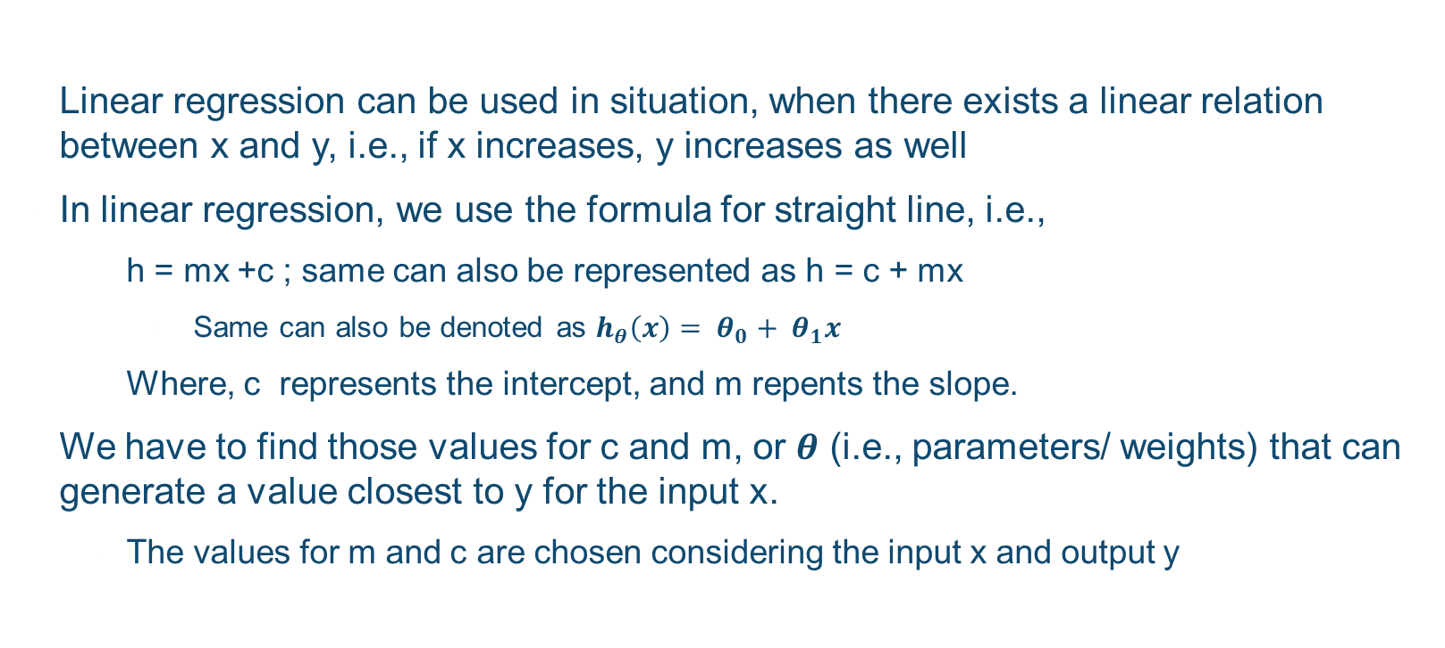
Linear Regression
Linear regression can be used in situation, when there exists a linear relation between x and y, i.e., if x increases, y increases as well
In linear regression, we use the formula for straight line, i.e.,
h = mx +c ; same can also be represented as h = c + mx
Same can also be denoted as $h_{θ}\left(x\right)= θ_{0}+ θ_{1}x$
Where, c represents the intercept, and m repents the slope.
We have to find those values for c and m, or $θ$ (i.e., parameters/ weights) that can generate a value closest to y for the input x.
The values for m and c are chosen considering the input x and output y

Slide 12
Linear Regression
For a dataset : {(1,4) , (3, 11), (4, 14), (6, 22)};
We have to find the values for c and m, such that the prediction value gained from the expression y’ = c + mx, should be close enough to original output y
If we consider c = 1, and m = 3, then
y’[1] = 1 + 3 * 1 = 4, y’[2] = 1 + 3 * 3 = 10, y’[3] = 1 + 3 * 4 = 13, y’[4] = 1 + 3 * 6 = 19
If we consider c = -2, and m = 4, then
y’[1] = -2 + 4 * 1 = 2, y’[2] = -2 + 4 * 3 = 10, y’[3] = -2 + 4 * 4 = 14, y’[4] = -2 + 4 * 6 = 22
There may be other values of m and c as well
BUT, which values for m and c should be chosen????
ANSWER: We should choses those values of m and c, for which the average or overall difference between predicted value y’[i] and original value y[i] is minimum or smallest.

Slide 13
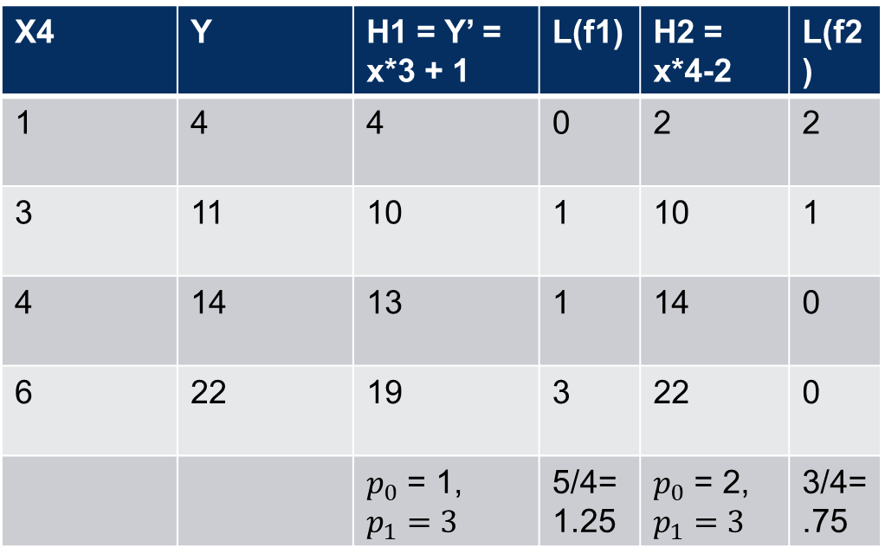
Linear Regression
How to find which values of m and c are the best??
For all X in the dataset
Place the values of x [i], m, and c, and calculate the y’ [i]
Find the difference between predicted y’[i] and original y[i]
Add the total difference
Find the average
The above mentioned algorithm is known as loss function or cost funtion
X4 | Y | H1 = Y’ = x*3 + 1 | L(f1) | H2 = x*4-2 | L(f2)
1 | 4 | 4 | 0 | 2 | 2
3 | 11 | 10 | 1 | 10 | 1
4 | 14 | 13 | 1 | 14 | 0
6 | 22 | 19 | 3 | 22 | 0
 |  | $p_{0}$ = 1, $p_{1}=3$ | 5/4=1.25 | $p_{0}$ = 2, $p_{1}=3$ | 3/4=.75

Slide 14
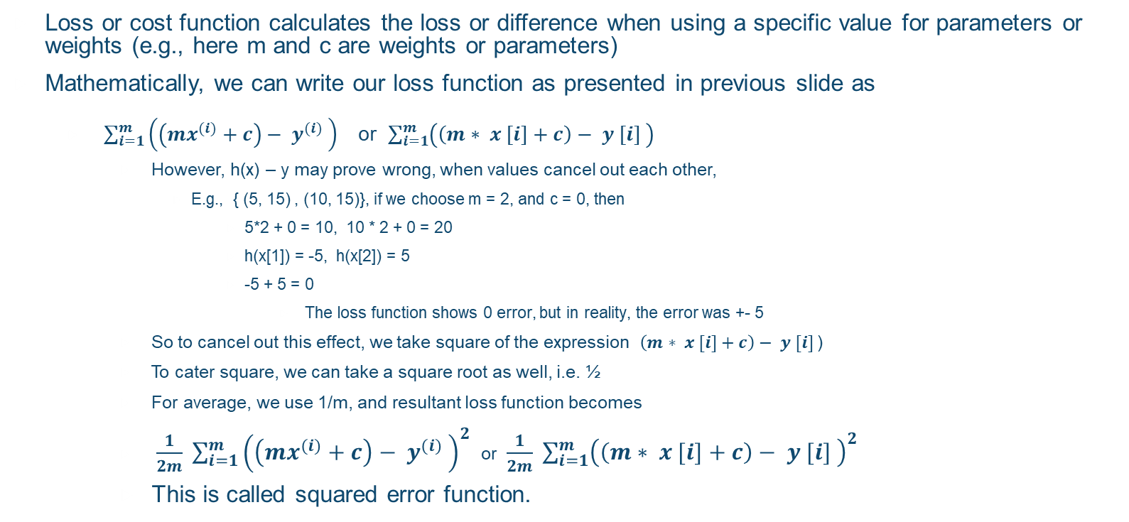
Loss function
Loss or cost function calculates the loss or difference when using a specific value for parameters or weights (e.g., here m and c are weights or parameters)
Mathematically, we can write our loss function as presented in previous slide as
$\sum_{i=1}^{m}{{\left(\left(mx^{(i)}+c\right)− y^{(i)} \right)}^{}}$ or $\sum_{i=1}^{m}{{\left(\left(m∗ x [i]+c\right)− y [i] \right)}^{}}$
However, h(x) – y may prove wrong, when values cancel out each other,
E.g., { (5, 15) , (10, 15)}, if we choose m = 2, and c = 0, then
5*2 + 0 = 10, 10 * 2 + 0 = 20
h(x[1]) = -5, h(x[2]) = 5
-5 + 5 = 0
The loss function shows 0 error, but in reality, the error was +- 5
So to cancel out this effect, we take square of the expression $\left(m∗ x [i]+c\right)− y [i]$)
To cater square, we can take a square root as well, i.e. ½
For average, we use 1/m, and resultant loss function becomes
$\frac{1}{2m} \sum_{i=1}^{m}{{\left(\left(mx^{(i)}+c\right)− y^{(i)} \right)}^{2}}$ or $\frac{1}{2m} \sum_{i=1}^{m}{{\left(\left(m∗ x [i]+c\right)− y [i] \right)}^{2}}$
This is called squared error function.

Slide 15
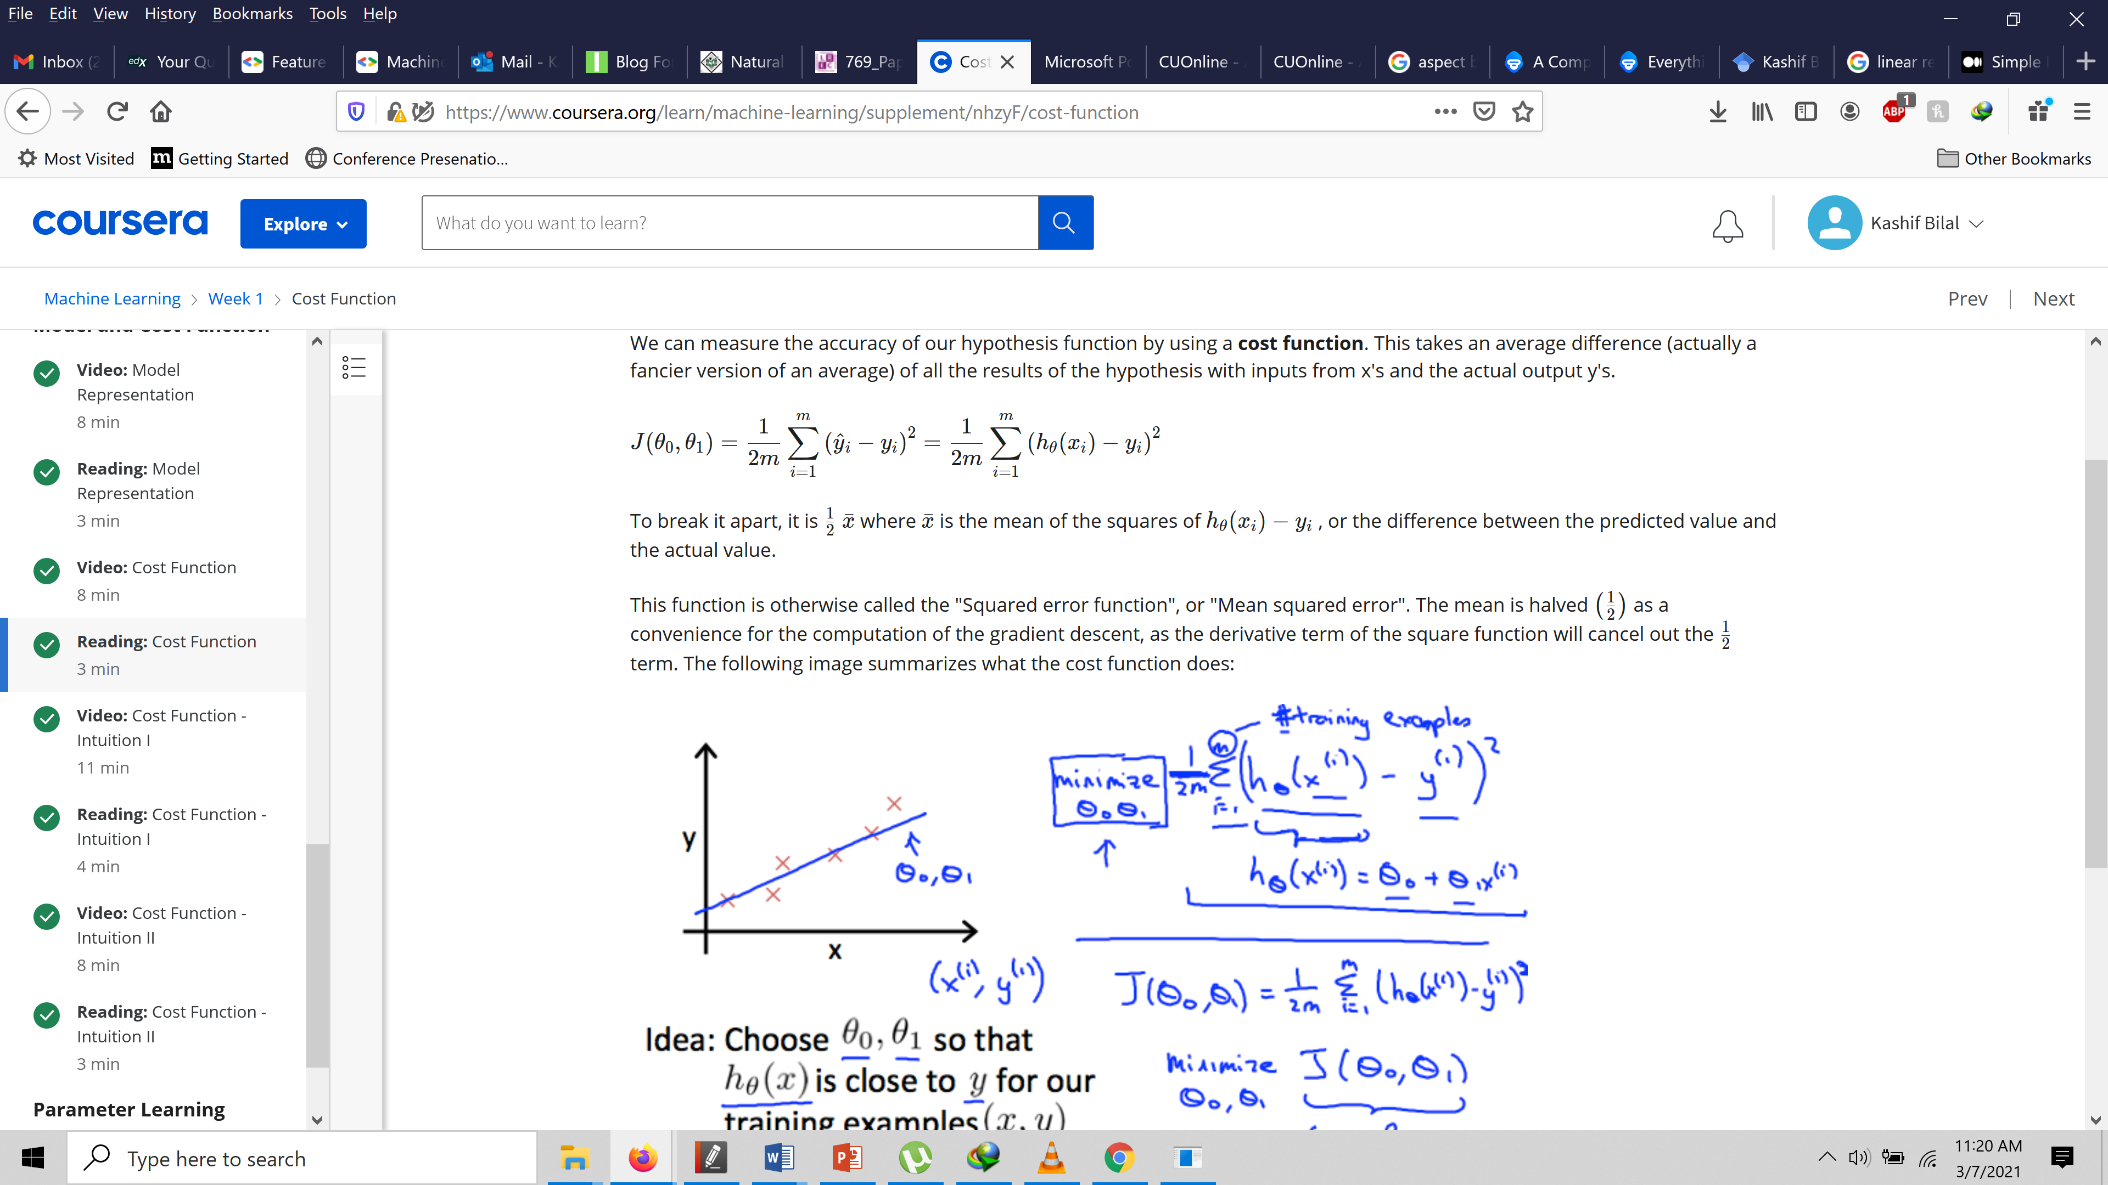
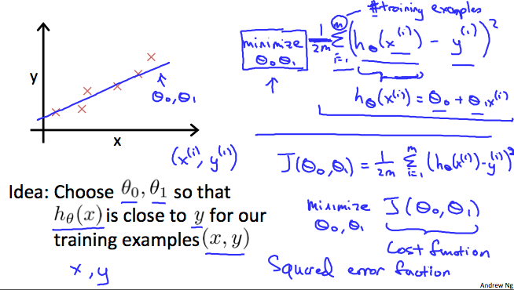
$\frac{1}{2n} \sum_{i=1}^{n}{{\left(\left(mx^{(i)}+c\right)− y^{(i)} \right)}^{2}}$ o$r\frac{1}{2n} \sum_{i=1}^{n}{{\left(\left(m∗ x [i]+c\right)− y [i] \right)}^{2}}$

Slide 16
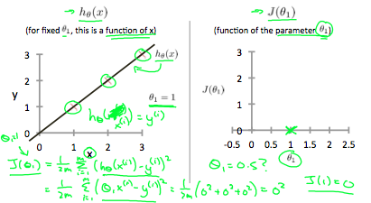
Cost Function
Dataset = {(1,1), (2,2), (3,3)}
If we try to think of it in visual terms, our training data set is scattered on the x-y plane. We are trying to make a straight line (defined by h (x)) which passes through these scattered data points.
Our objective is to get the best possible line.
The best possible line will be such so that the average squared vertical distances of the scattered points from the line will be the least. Ideally, the line should pass through all the points of our training data set. In such a case, the value of J(θ0,θ1) will be 0.

Slide 17
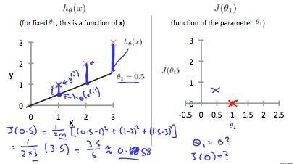
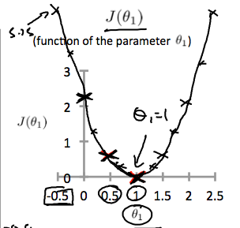
Cost Function
When θ1​=1, we get a slope of 1 which goes through every single data point in our model.
Conversely, when θ1​=0.5, we see the vertical distance from our fit to the data points increase.
Plotting several other points yields to the bottom right graph

Slide 18
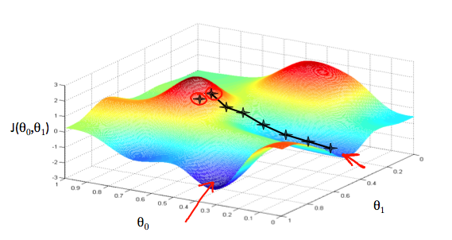
Parameters Learning
We have understood that the optimal parameters (weights; i.e., m and c or theta) are required for accurate predictions.
BUT, how to find the parameter values??
Gradient Decent algorithm is used to minimize some function J
Start with some value of parameters (m and c or theta)
Keep changing parameters to reduce J (loss function)
Until the parameters values stop changing or a specific limit is reached.

Slide 19
Gradiant Decent
As we saw that our loss function is a convex function, i.e. bow shaped function having just 1 minimum point.
So at any point, we have to find the slope along the curve
This can be done by taking derivative
Derivative lets us find the rate of change in a curve
The slope of the tangent is the derivative at that point and it will give us a direction to move towards. We make steps down the cost function in the direction with the steepest descent. The size of each step is determined by the parameter α, which is called the learning rate.
For example, the distance between each 'star' in the graph above represents a step determined by our parameter α. A smaller α would result in a smaller step and a larger α results in a larger step.

Slide 20
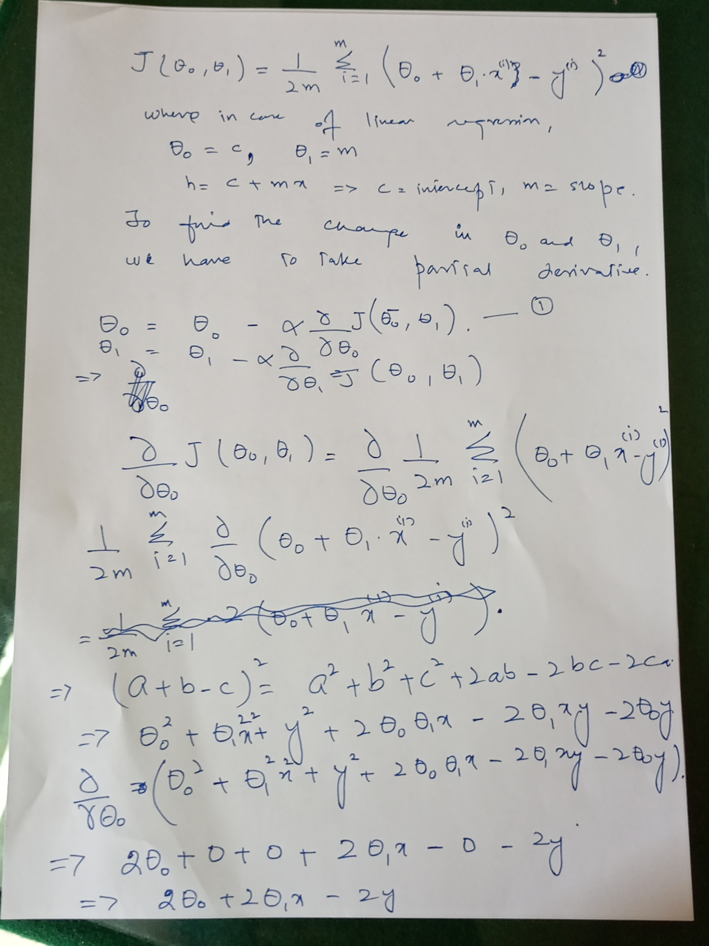
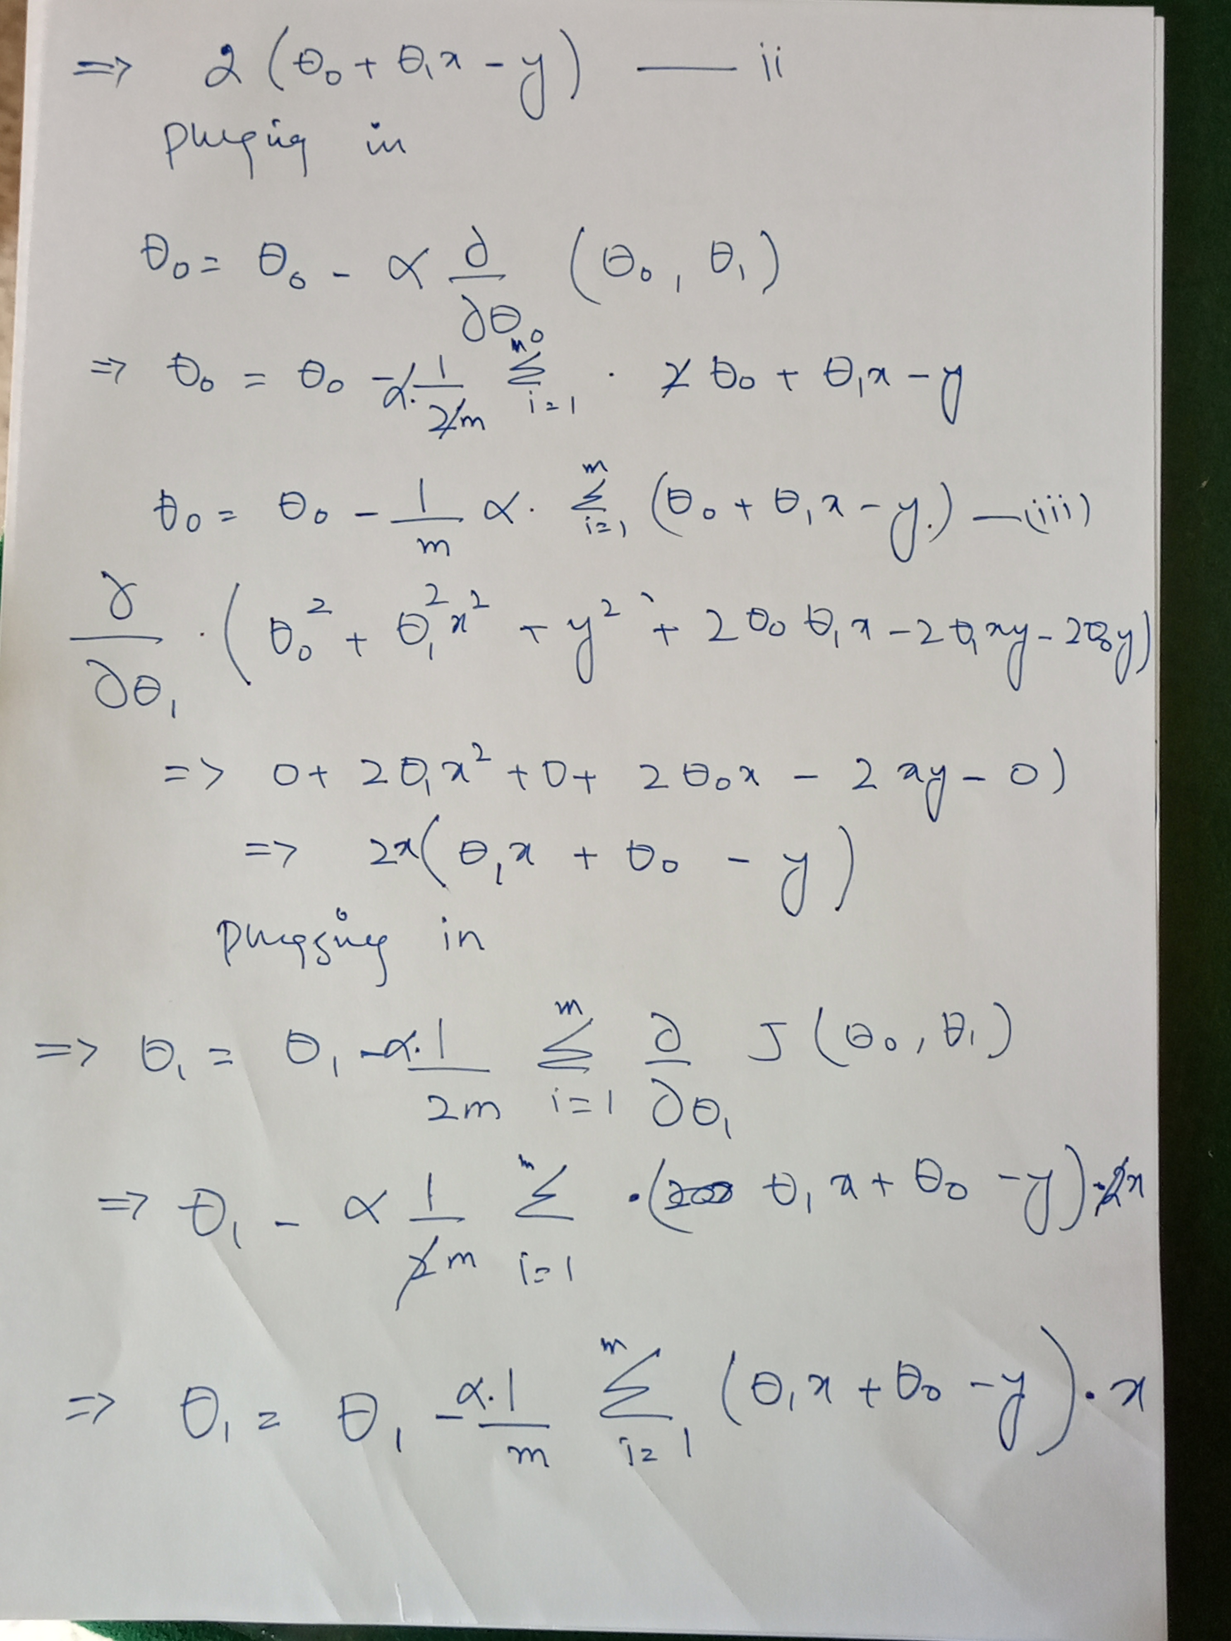
Derivation

Slide 21
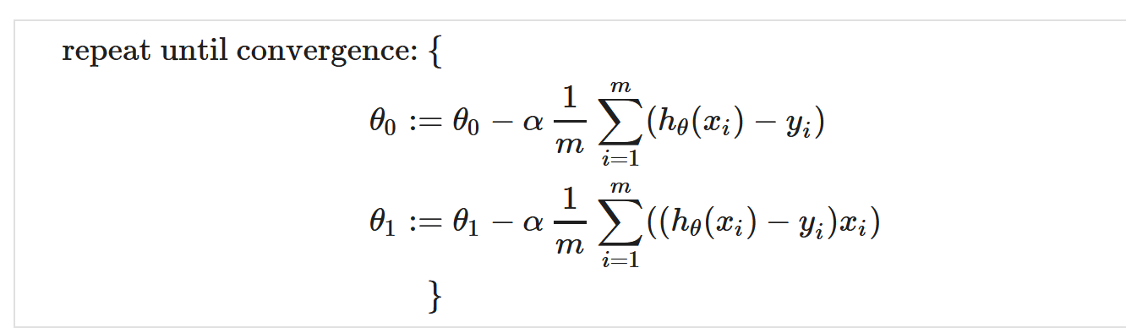
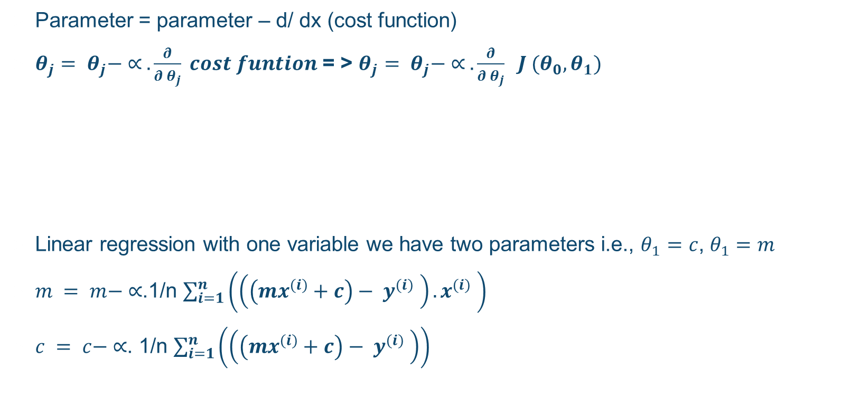
Gradient Decent
Parameter = parameter – d/ dx (cost function)
$θ_{j}= θ_{j}− ∝ . \frac{∂}{∂ θ_{j}} cost funtion$ = > $θ_{j}= θ_{j}− ∝ . \frac{∂}{∂ θ_{j}} J (θ_{0}, θ_{1})$
Linear regression with one variable we have two parameters i.e., $θ_{1}=c$, $θ_{1}=m$
$m = m− ∝$.1/n $\sum_{i=1}^{n}{\left(\left(\left(mx^{(i)}+c\right)− y^{(i)} \right). x^{(i)} \right)}$
$c = c− ∝$. 1/n $\sum_{i=1}^{n}{\left(\left(\left(mx^{(i)}+c\right)− y^{(i)} \right)\right)}$

Slide 22
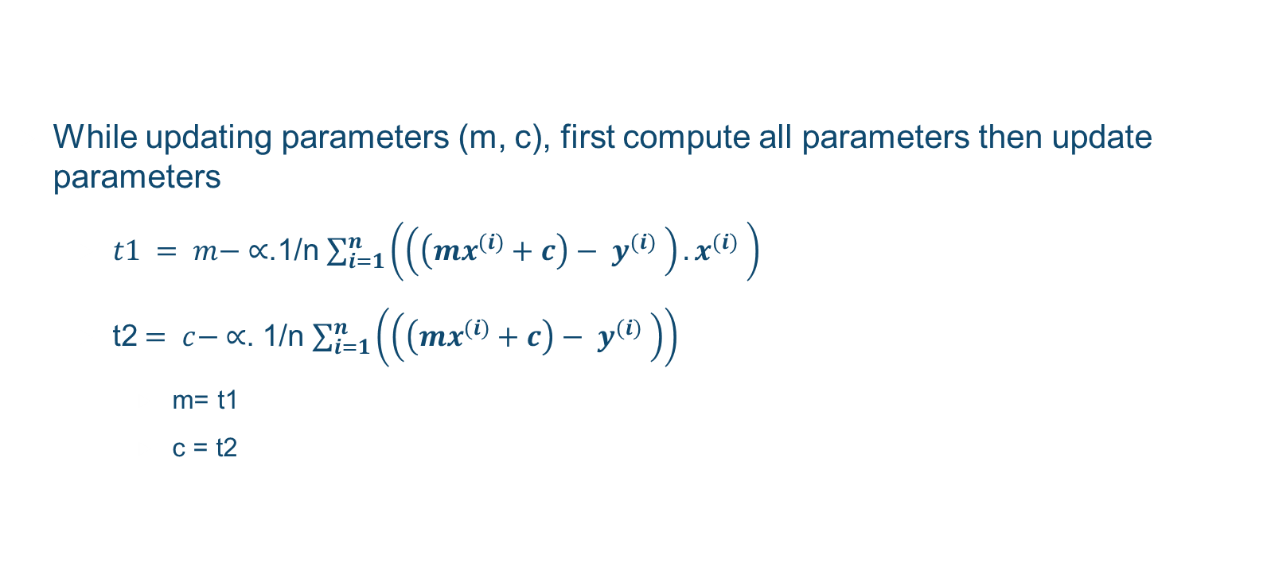
Remember
While updating parameters (m, c), first compute all parameters then update parameters
$t1 = m− ∝$.1/n $\sum_{i=1}^{n}{\left(\left(\left(mx^{(i)}+c\right)− y^{(i)} \right). x^{(i)} \right)}$
t2$= c− ∝$. 1/n $\sum_{i=1}^{n}{\left(\left(\left(mx^{(i)}+c\right)− y^{(i)} \right)\right)}$
m= t1
c = t2

Slide 23
Implementation
def hypothesis( inp, m, c):
h = c + inp * m
return h
def CostFun(m,c):
sum = 0
for i in range (count):
sum+= ((m*x[i] + c)-y[i]) ** 2
error = sum/(2*count)
return error

Slide 24
Gradient Decent
def GD(m,c,lr):
um=0
uc=0
for i in range (count):
um+= (m*x[i] + c - y[i]) * x[i]
uc = (m*x[i] + c - y[i])
m = m - lr * um/ count
c = c - lr * uc/count
return m,c
import matplotlib.pyplot as plt
def plotit(x,y):
plt.plot(x,y)
plt.show()
def GDLearning():
lr = 0.01
m=0
c=0
epocs = 100
for i in range (epocs):
res.append(CostFunSimple(m,c))
m,c = GD(m,c,lr)
#res = ['%.2f' %i for i in res]
plotit(x,y)
plotit(range(epocs),res)
print (res[epocs-1])

Slide 25
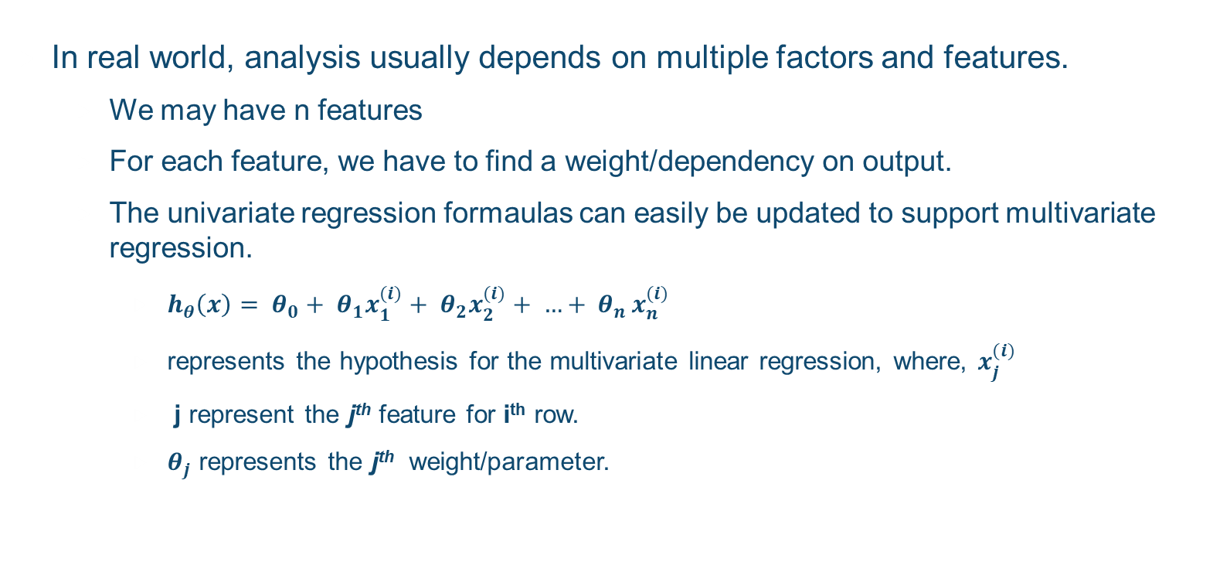
Multivariate Regression
In real world, analysis usually depends on multiple factors and features.
We may have n features
For each feature, we have to find a weight/dependency on output.
The univariate regression formaulas can easily be updated to support multivariate regression.
$h_{θ}\left(x\right)= θ_{0}+ θ_{1}x_{1}^{(i)}+ θ_{2}x_{2}^{(i)}+ {…+ θ}_{n}x_{n}^{(i)}$
represents the hypothesis for the multivariate linear regression, where, $x_{j}^{(i)}$
j represent the j^{th} feature for i^{th} row.
$θ_{j}$ represents the j^{th} weight/parameter.

Slide 26
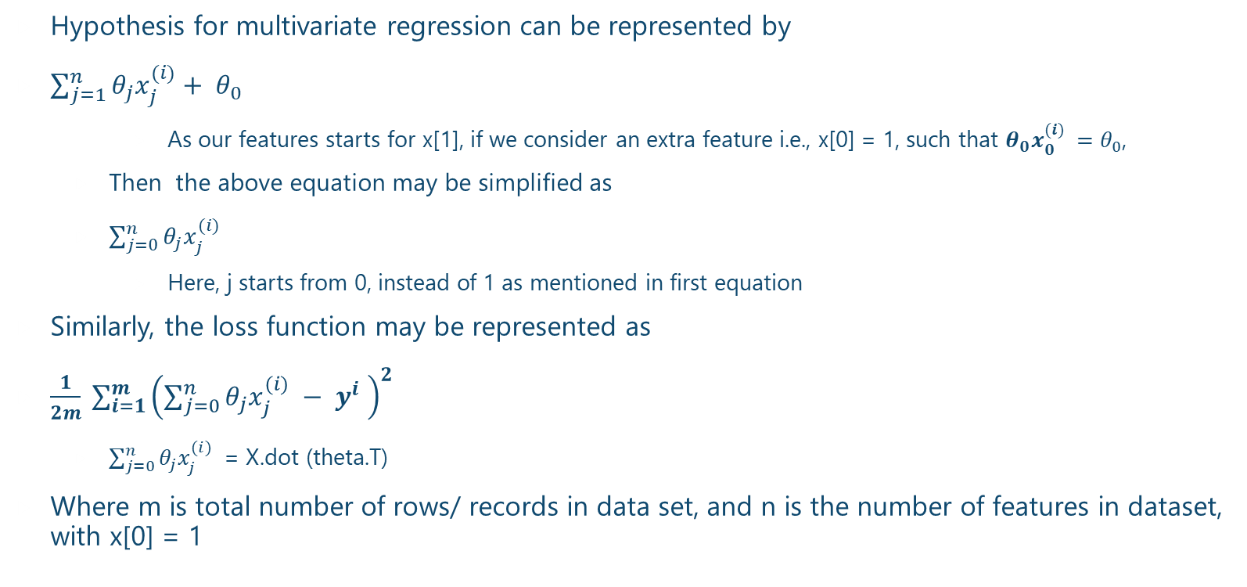
Multivariate Regression
Hypothesis for multivariate regression can be represented by
$\sum_{j=1}^{n}{θ_{j}x_{j}^{(i)}+ θ_{0} }$
As our features starts for x[1], if we consider an extra feature i.e., x[0] = 1, such that $θ_{0}x_{0}^{(i)} =θ_{0}$,
Then the above equation may be simplified as
$\sum_{j=0}^{n}{θ_{j}x_{j}^{(i)} }$
Here, j starts from 0, instead of 1 as mentioned in first equation
Similarly, the loss function may be represented as
$\frac{1}{2m} \sum_{i=1}^{m}{{\left(\sum_{j=0}^{n}{θ_{j}x_{j}^{(i)} }− y^{i} \right)}^{2}}$
$\sum_{j=0}^{n}{θ_{j}x_{j}^{(i)} }$ = X.dot (theta.T)
Where m is total number of rows/ records in data set, and n is the number of features in dataset, with x[0] = 1

Slide 27
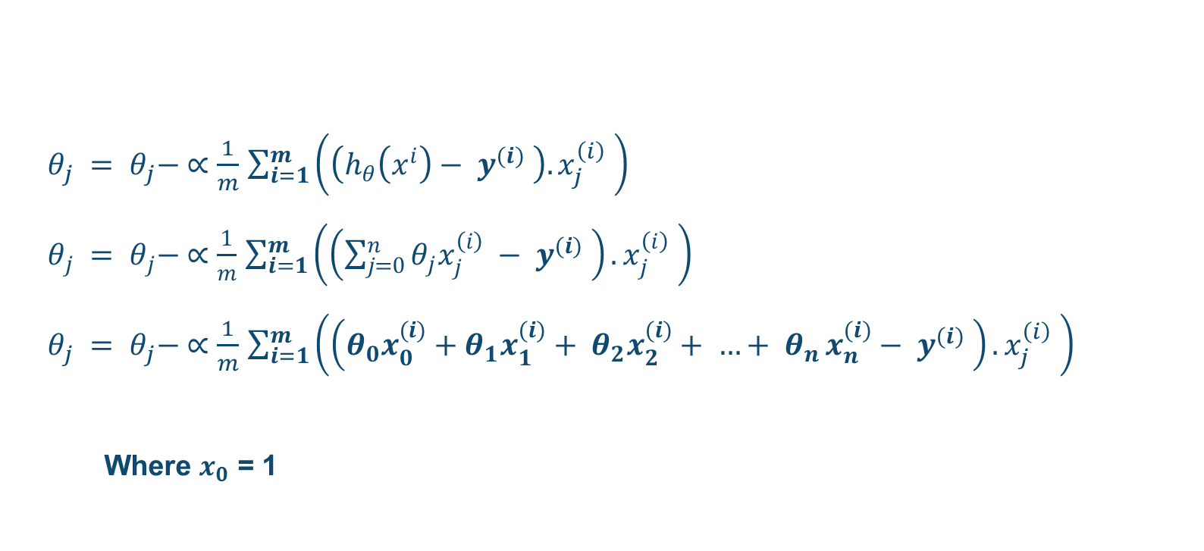
Gradient decent for multivariate regression
$θ_{j} = θ_{j}− ∝\frac{1}{m}$ $\sum_{i=1}^{m}{\left(\left(h_{θ}\left(x^{i}\right)− y^{(i)} \right). x_{j}^{\left(i\right)} \right)}$
$θ_{j} = θ_{j}− ∝\frac{1}{m}$ $\sum_{i=1}^{m}{\left(\left(\sum_{j=0}^{n}{θ_{j}x_{j}^{\left(i\right)} }− y^{(i)} \right). x_{j}^{\left(i\right)} \right)}$
$θ_{j} = θ_{j}− ∝\frac{1}{m}$ $\sum_{i=1}^{m}{\left(\left(θ_{0}x_{0}^{(i)}+θ_{1}x_{1}^{(i)}+ θ_{2}x_{2}^{(i)}+ {…+ θ}_{n}x_{n}^{(i)}− y^{(i)} \right). x_{j}^{\left(i\right)} \right)}$
Where $x_{0}$ = 1

Slide 28
Polynomial Regression
Some times our data is not linear
Then we may apply polynomial regression
E.g., We may use Quadratic function instead of linear function
ax² + bx + c
We now need to have 3 parameters and corresponding 3 x values
For c , x value is 1
For a, we have to multiply x *x
For b, we use x
We have to redefine the hypothesis and corresponding loss function.
We may also use normal equation for polynomial regression

Slide 29
Normal equation
We can also find the parameters mathematically
(X^{t} X) ⁻¹ X^{t}y
However, normal equation method just works in regression problems and not in classification
Inverse of matrix finding is
Computational intensive
Feasible for problems up to some hundreds of parameters
Doesn’t need to adjust learning rate nor requires multiple iterations
Its complexity is O (n³)
In comparison, complexity of gradient decent is O (kn²)
Every matrix doesn’t have inverse, but its quite rare

Slide 30
Feature scaling
We can speed up gradient descent by having each of our input values in roughly the same range. This is because θ will descend quickly on small ranges and slowly on large ranges, and so will oscillate inefficiently down to the optimum when the variables are very uneven.
The way to prevent this is to modify the ranges of our input variables so that they are all roughly the same. Ideally:
−1 ≤ x_i ≤ 1
Two techniques to help with this are feature scaling and mean normalization.
Feature scaling involves dividing the input values by the range (i.e. the maximum value minus the minimum value) of the input variable, resulting in a new range of just 1.
Mean normalization involves subtracting the average value for an input variable from the values for that input variable resulting in a new average value for the input variable. To implement both of these techniques, adjust your input values as shown in this formula:
xi:=xi−μi / si​​
Where μi​ is the average of all the values for feature (i) and si​ is the range of values (max - min), or si is the standard deviation.
We can combine multiple features into one. For example, we can combine x1 and x2 into a new feature x3 by taking x1 * x2.

Slide 31
Logistic regression
Linear regression deals with regression problems, i.e., predicting continuous results
Classification deals with discrete outputs in finite classes
The classification problem is just like the regression problem, except that the values we now want to predict take on only a small number of discrete values.
When the output has only 2 classes, its called binary classification
E.g., a mail can either be spam or not spam
A customer will either buy a product or not
A viewer will either watch an ad or not
A student will either fail or pass the course
Given x^{i} , the corresponding y^{i} is called label

Slide 32
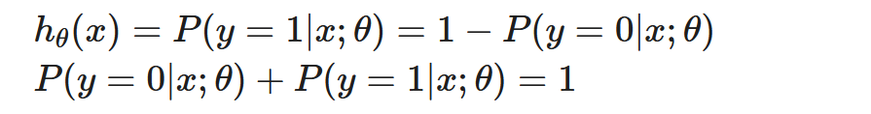
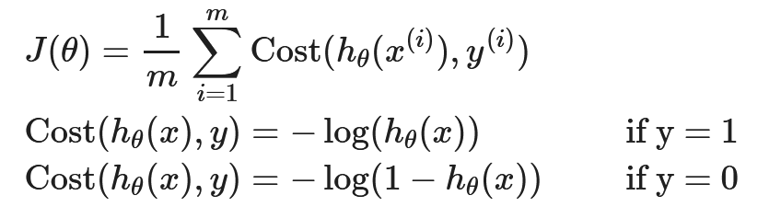
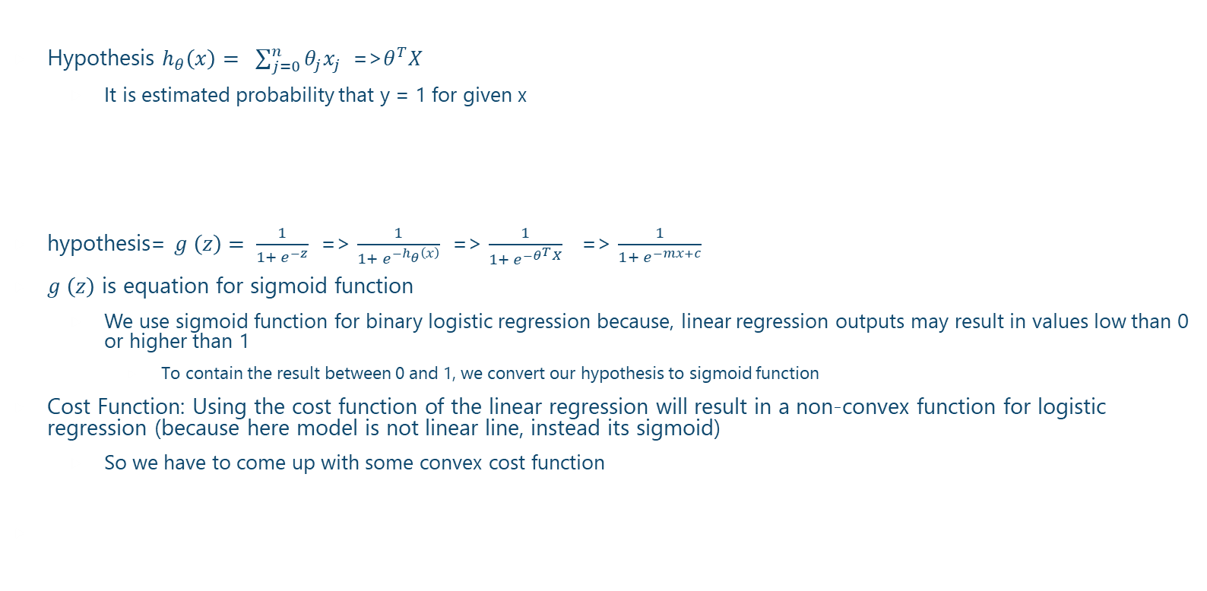
Logistic regression
Hypothesis $h_{θ}\left(x\right)= \sum_{j=0}^{n}{θ_{j}x_{j} }$ =>$θ^{T}X$
It is estimated probability that y = 1 for given x
hypothesis= $g \left(z\right)= \frac{1}{1+ e^{−z}}$ => $\frac{1}{1+ e^{−h_{θ}\left(x\right)}}$ => $\frac{1}{1+ e^{−θ^{T}X}}$ => $\frac{1}{1+ e^{−mx+c}}$
$g \left(z\right)$ is equation for sigmoid function
We use sigmoid function for binary logistic regression because, linear regression outputs may result in values low than 0 or higher than 1
To contain the result between 0 and 1, we convert our hypothesis to sigmoid function
Cost Function: Using the cost function of the linear regression will result in a non-convex function for logistic regression (because here model is not linear line, instead its sigmoid)
So we have to come up with some convex cost function

Slide 33
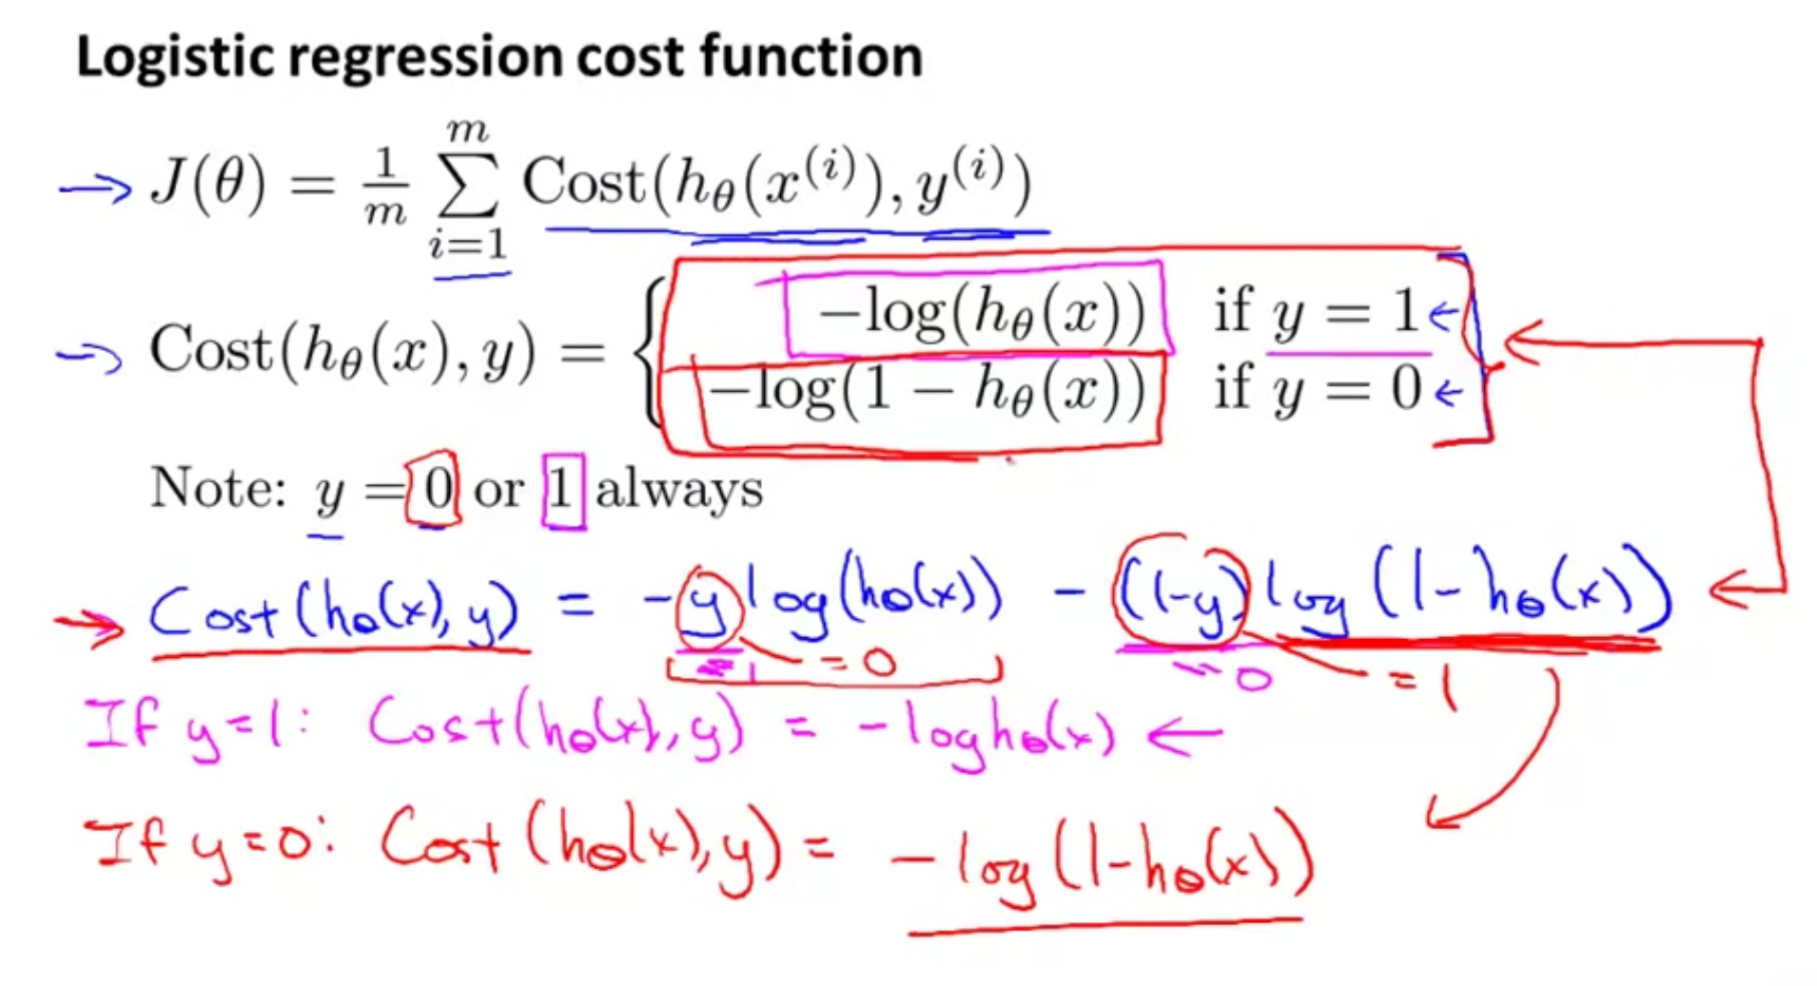

Slide 34
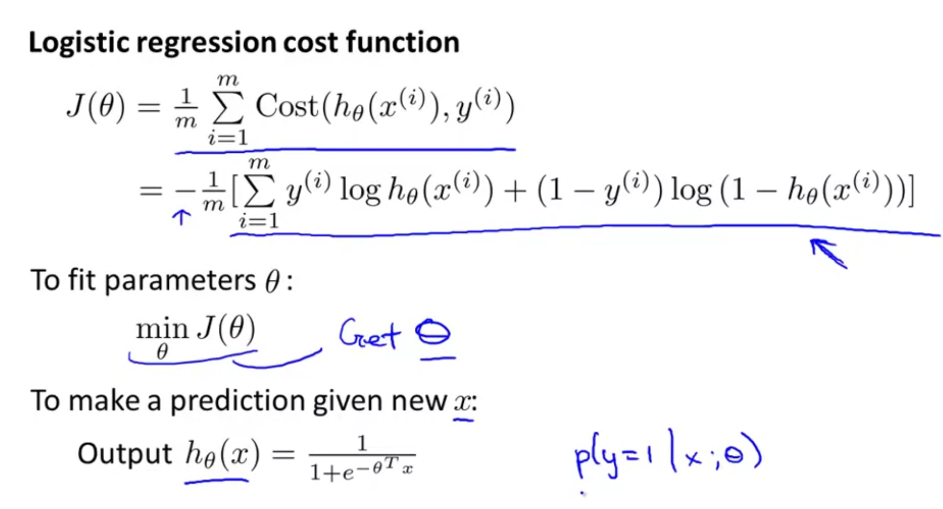

Slide 35
